Slide 1

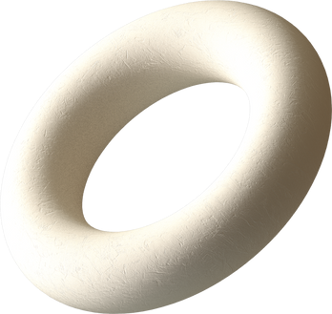
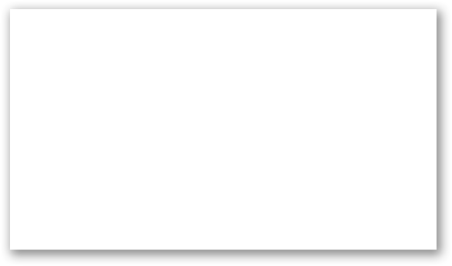
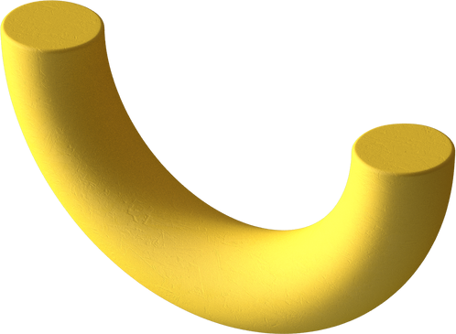
Python

Slide 2


Machine Learning - Standard Deviation
What is Standard Deviation?
Standard deviation is a number that describes how spread out the values are.
A low standard deviation means that most of the numbers are close to the mean (average) value.
A high standard deviation means that the values are spread out over a wider range.

Slide 3
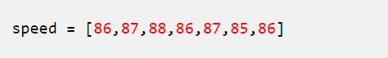
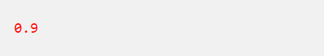
Machine Learning - Standard Deviation
Example: This time we have registered the speed of 7 cars:
The standard deviation is:

Slide 4
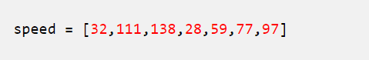
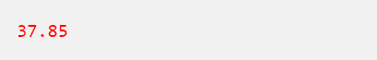
Machine Learning - Standard Deviation
Meaning that most of the values are within the range of 0.9 from the mean value, which is 86.4.
Let us do the same with a selection of numbers with a wider range:
The standard deviation is:

Slide 5
Machine Learning - Standard Deviation
Meaning that most of the values are within the range of 37.85 from the mean value, which is 77.4.
As you can see, a higher standard deviation indicates that the values are spread out over a wider range.
The NumPy module has a method to calculate the standard deviation:

Slide 6
Machine Learning - Percentiles
What are Percentiles?
Percentiles are used in statistics to give you a number that describes the value that a given percent of the values are lower than.
Example: Let's say we have an array of the ages of all the people that lives in a street.

Slide 7
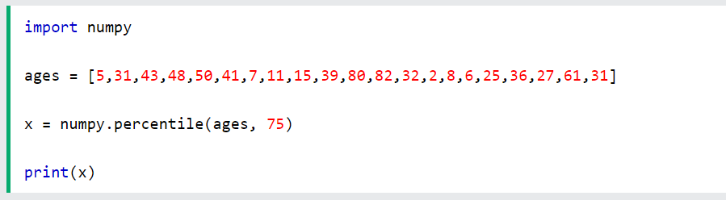
Machine Learning - Percentiles
What is the 75. percentile? The answer is 43, meaning that 75% of the people are 43 or younger.
The NumPy module has a method for finding the specified percentile:
Example
Use the NumPy percentile() method to find the percentiles:

Slide 8
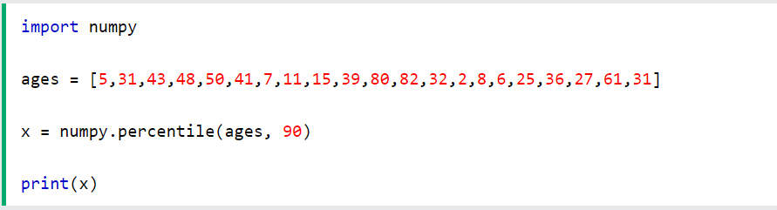
Machine Learning - Standard Deviation
Example
What is the age that 90% of the people are younger than?

Slide 9
Machine Learning - Data Distribution
Data Distribution
Earlier in this tutorial we have worked with very small amounts of data in our examples, just to understand the different concepts.
In the real world, the data sets are much bigger, but it can be difficult to gather real world data, at least at an early stage of a project.

Slide 10
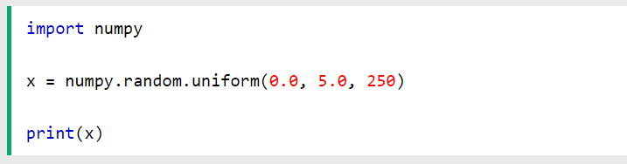
Machine Learning - Data Distribution
How Can we Get Big Data Sets?
To create big data sets for testing, we use the Python module NumPy, which comes with a number of methods to create random data sets, of any size.
Example
Create an array containing 250 random floats between 0 and 5:

Slide 11
Machine Learning - Data Distribution
Histogram
To visualize the data set we can draw a histogram with the data we collected.
We will use the Python module Matplotlib to draw a histogram.
Learn about the Matplotlib module in our Matplotlib Tutorial.

Slide 12
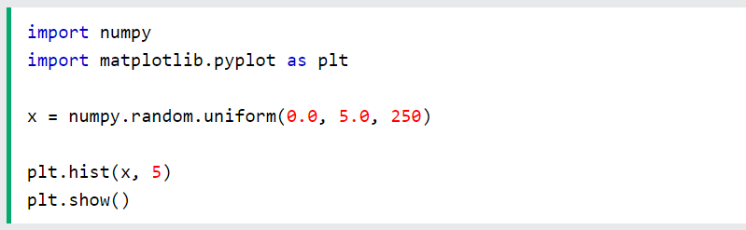
Machine Learning - Data Distribution
Example
Draw a histogram:

Slide 13
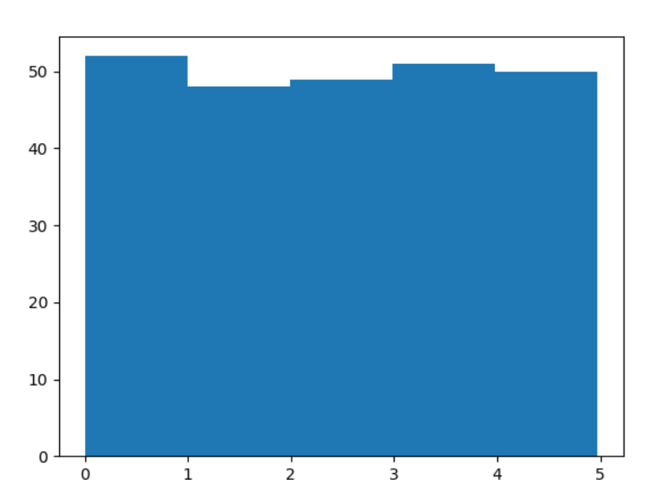
Machine Learning - Data Distribution
Result:

Slide 14
Machine Learning - Data Distribution
Histogram Explained
We use the array from the example above to draw a histogram with 5 bars.
The first bar represents how many values in the array are between 0 and 1.
The second bar represents how many values are between 1 and 2.
Etc.

Slide 15
Machine Learning - Data Distribution
Which gives us this result:
52 values are between 0 and 1
48 values are between 1 and 2
49 values are between 2 and 3
51 values are between 3 and 4
50 values are between 4 and 5
Note: The array values are random numbers and will not show the exact same result on your computer.

Slide 16
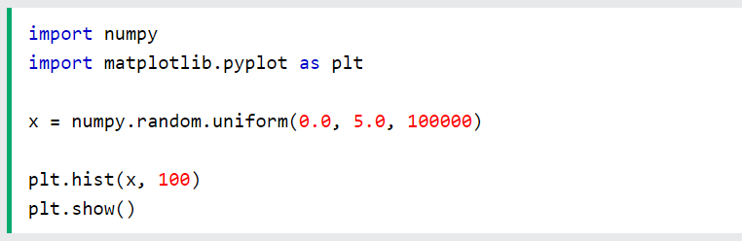
Machine Learning - Data Distribution
Big Data Distributions
An array containing 250 values is not considered very big, but now you know how to create a random set of values, and by changing the parameters, you can create the data set as big as you want.
Example
Create an array with 100000 random numbers, and display them using a histogram with 100 bars:

Slide 17
Machine Learning - Data Distribution
Normal Data Distribution
In the previous chapter we learned how to create a completely random array, of a given size, and between two given values.
In this chapter we will learn how to create an array where the values are concentrated around a given value.
In probability theory this kind of data distribution is known as the normal data distribution, or the Gaussian data distribution, after the mathematician Carl Friedrich Gauss who came up with the formula of this data distribution.

Slide 18
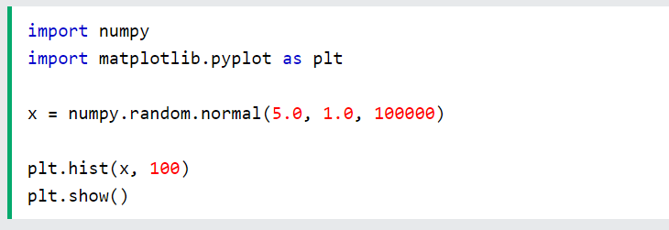
Machine Learning - Data Distribution
Example
A typical normal data distribution:

Slide 19
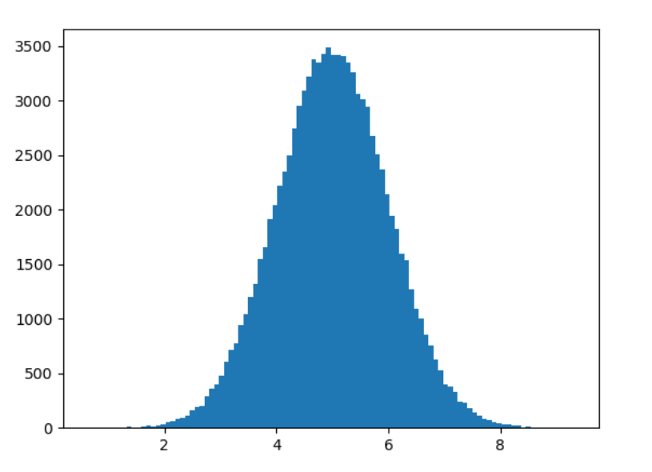
Machine Learning - Data Distribution
Result:

Slide 20
Machine Learning - Data Distribution
Histogram Explained
We use the array from the numpy.random.normal() method, with 100000 values, to draw a histogram with 100 bars.
We specify that the mean value is 5.0, and the standard deviation is 1.0.
Meaning that the values should be concentrated around 5.0, and rarely further away than 1.0 from the mean.
And as you can see from the histogram, most values are between 4.0 and 6.0, with a top at approximately 5.0.

Slide 21
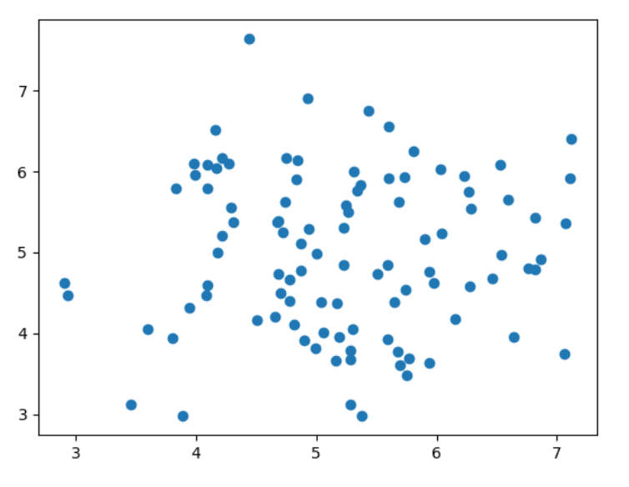
Machine Learning - Scatter Plot
Scatter Plot
A scatter plot is a diagram where each value in the data set is represented by a dot.

Slide 22
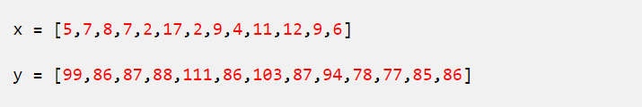
Machine Learning - Scatter Plot
The Matplotlib module has a method for drawing scatter plots, it needs two arrays of the same length, one for the values of the x-axis, and one for the values of the y-axis:
The x array represents the age of each car.
The y array represents the speed of each car.

Slide 23
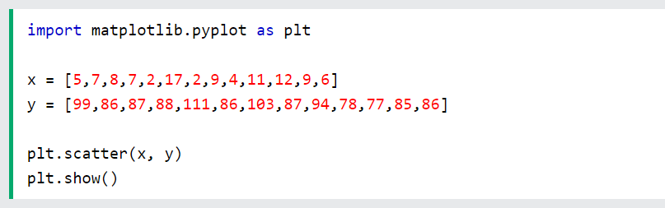
Machine Learning - Scatter Plot
Example
Use the scatter() method to draw a scatter plot diagram:

Slide 24
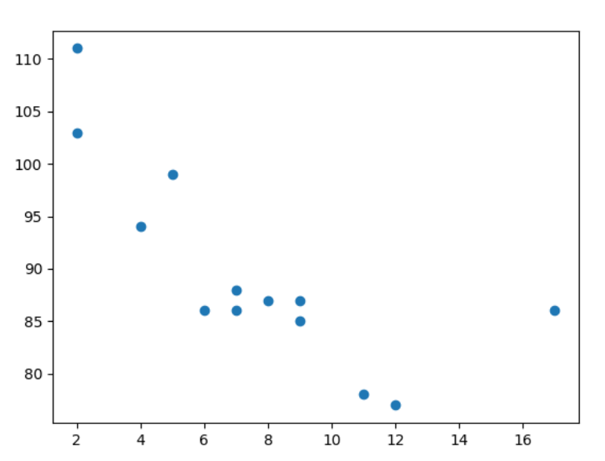
Machine Learning - Scatter Plot
Result:

Slide 25
Machine Learning - Scatter Plot
Scatter Plot Explained
The x-axis represents ages, and the y-axis represents speeds.
What we can read from the diagram is that the two fastest cars were both 2 years old, and the slowest car was 12 years old.
Note: It seems that the newer the car, the faster it drives, but that could be a coincidence, after all we only registered 13 cars.

Slide 26
Machine Learning - Scatter Plot
Random Data Distributions
In Machine Learning the data sets can contain thousands-, or even millions, of values.
You might not have real world data when you are testing an algorithm, you might have to use randomly generated values.
As we have learned in the previous chapter, the NumPy module can help us with that!
Let us create two arrays that are both filled with 1000 random numbers from a normal data distribution.
The first array will have the mean set to 5.0 with a standard deviation of 1.0.

Slide 27
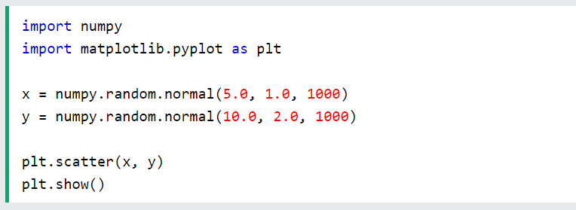
Machine Learning - Scatter Plot
Example
A scatter plot with 1000 dots:

Slide 28
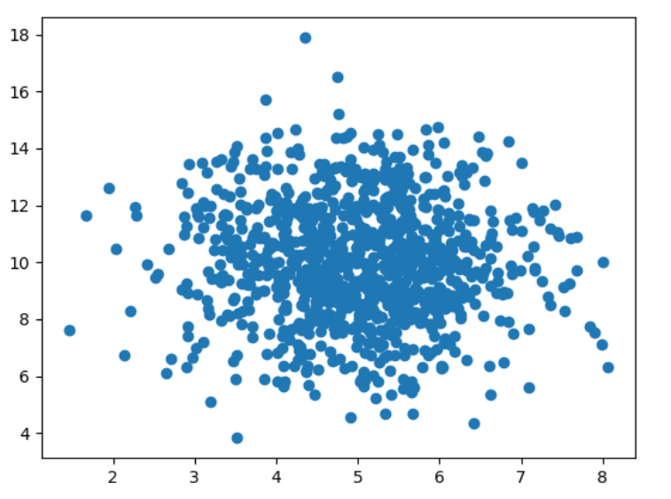
Machine Learning - Scatter Plot
Result:

Slide 29
Machine Learning - Scatter Plot
Scatter Plot Explained
We can see that the dots are concentrated around the value 5 on the x-axis, and 10 on the y-axis.
We can also see that the spread is wider on the y-axis than on the x-axis.

Slide 30
Machine Learning - Linear Regression
Regression
The term regression is used when you try to find the relationship between variables.
In Machine Learning, and in statistical modeling, that relationship is used to predict the outcome of future events.

Slide 31
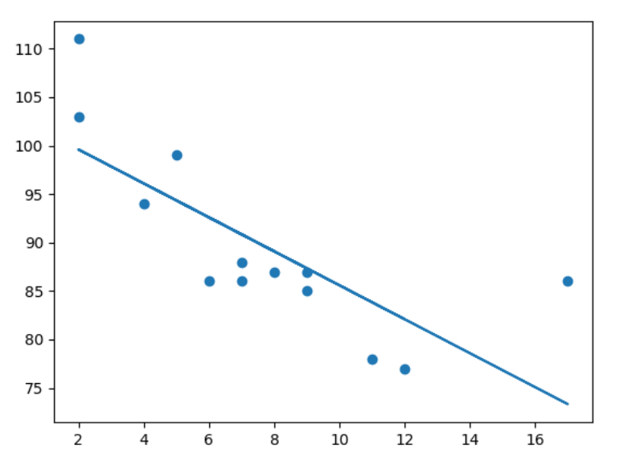
Machine Learning - Linear Regression
Linear Regression
Linear regression uses the relationship between the data-points to draw a straight line through all them.
This line can be used to predict future values.

Slide 32
Machine Learning - Linear Regression
Linear Regression
Linear regression uses the relationship between the data-points to draw a straight line through all them.
This line can be used to predict future values. In Machine Learning, predicting the future is very important.

Slide 33
Machine Learning - Linear Regression
How Does it Work?
Python has methods for finding a relationship between data-points and to draw a line of linear regression. We will show you how to use these methods instead of going through the mathematic formula.
In the example below, the x-axis represents age, and the y-axis represents speed. We have registered the age and speed of 13 cars as they were passing a tollbooth. Let us see if the data we collected could be used in a linear regression:

Slide 34
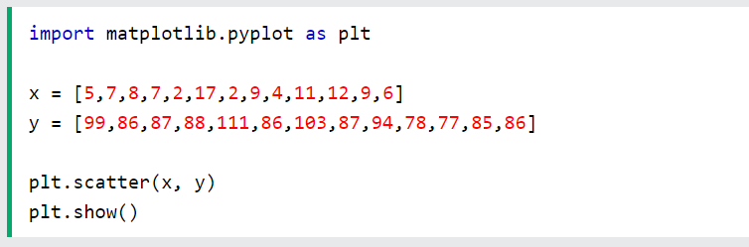
Machine Learning - Linear Regression
Example
Start by drawing a scatter plot:

Slide 35
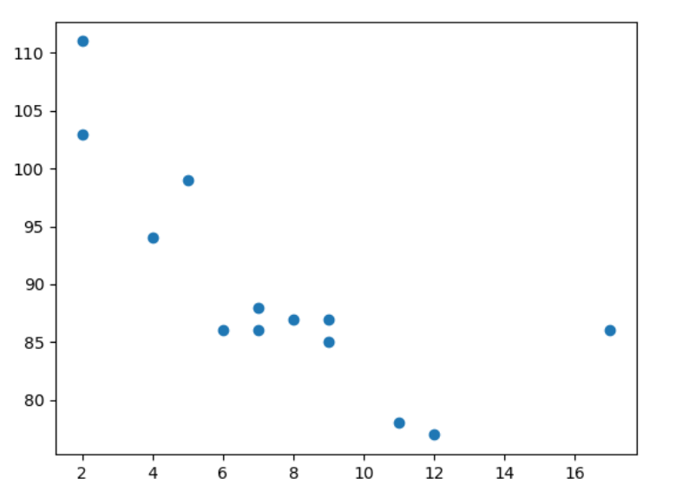
Machine Learning - Linear Regression
Result:

Slide 36
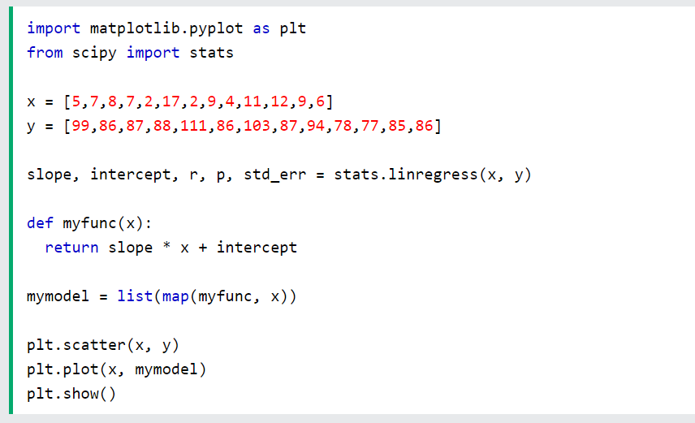
Machine Learning - Linear Regression
Example
Import scipy and draw the line of Linear Regression:

Slide 37
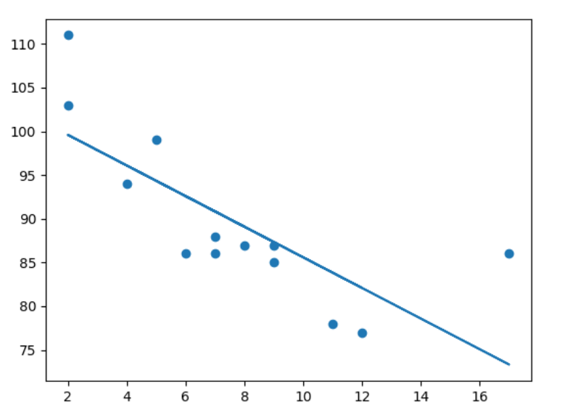
Machine Learning - Linear Regression
Result:

Slide 38
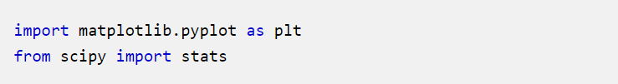
Machine Learning - Linear Regression
Example Explained
Import the modules you need.
You can learn about the Matplotlib module in our Matplotlib Tutorial.
You can learn about the SciPy module in our SciPy Tutorial.

Slide 39
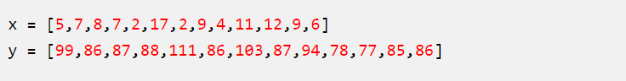
Machine Learning - Linear Regression
Create the arrays that represent the values of the x and y axis:
Execute a method that returns some important key values of Linear Regression:

Slide 40
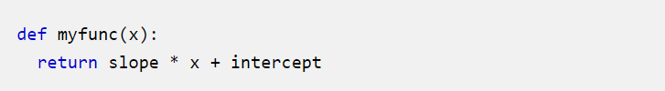
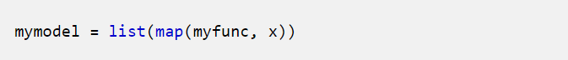
Machine Learning - Linear Regression
Create a function that uses the slope and intercept values to return a new value. This new value represents where on the y-axis the corresponding x value will be placed:
Run each value of the x array through the function. This will result in a new array with new values for the y-axis:

Slide 41
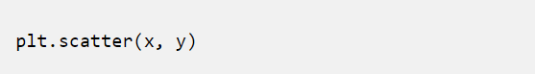
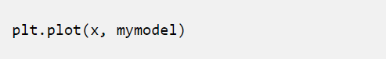
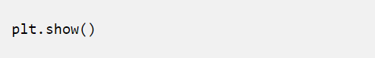
Machine Learning - Linear Regression
Draw the original scatter plot:
Draw the line of linear regression:
Display the diagram:

Slide 42
Machine Learning - Linear Regression
R for Relationship
It is important to know how the relationship between the values of the x-axis and the values of the y-axis is, if there are no relationship the linear regression can not be used to predict anything.
This relationship - the coefficient of correlation - is called r.
The r value ranges from -1 to 1, where 0 means no relationship, and 1 (and -1) means 100% related.
Python and the Scipy module will compute this value for you, all you have to do is feed it with the x and y values.

Slide 43
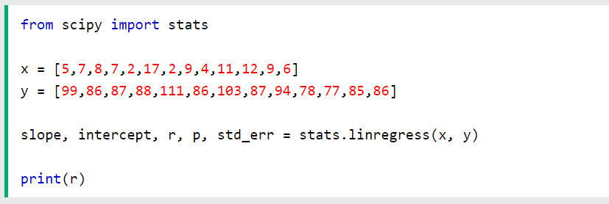
Machine Learning - Linear Regression
Example
How well does my data fit in a linear regression?

Slide 44
Machine Learning - Linear Regression
Example
How well does my data fit in a linear regression?
Note: The result -0.76 shows that there is a relationship, not perfect, but it indicates that we could use linear regression in future predictions.

Slide 45
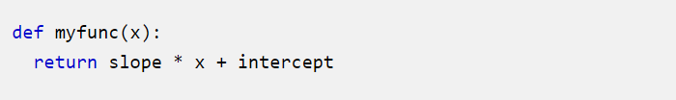
Machine Learning - Linear Regression
Predict Future Values
Now we can use the information we have gathered to predict future values.
Example: Let us try to predict the speed of a 10 years old car.
To do so, we need the same myfunc() function from the example above:

Slide 46
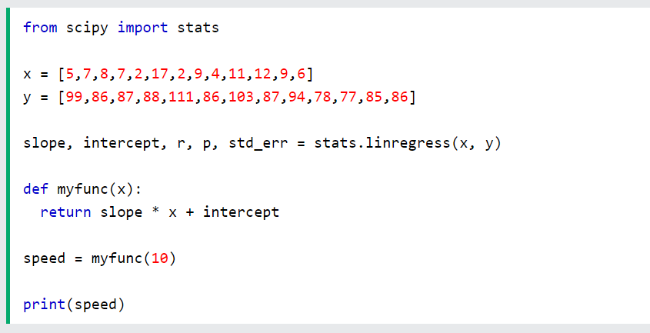
Machine Learning - Linear Regression
Example
Predict the speed of a 10 years old car:

Slide 47
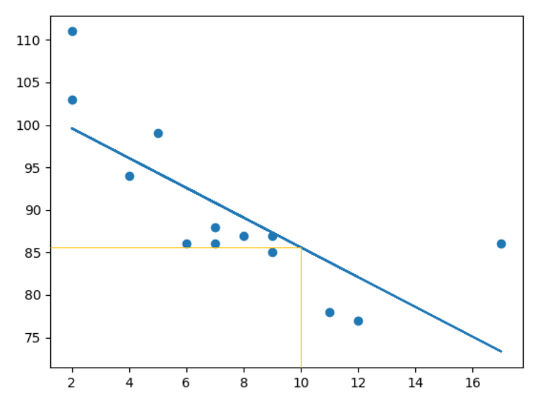
Machine Learning - Linear Regression
The example predicted a speed at 85.6, which we also could read from the diagram:

Slide 48
Machine Learning - Linear Regression
Bad Fit?
Let us create an example where linear regression would not be the best method to predict future values.
Example
These values for the x- and y-axis should result in a very bad fit for linear regression:
Continue…

Slide 49
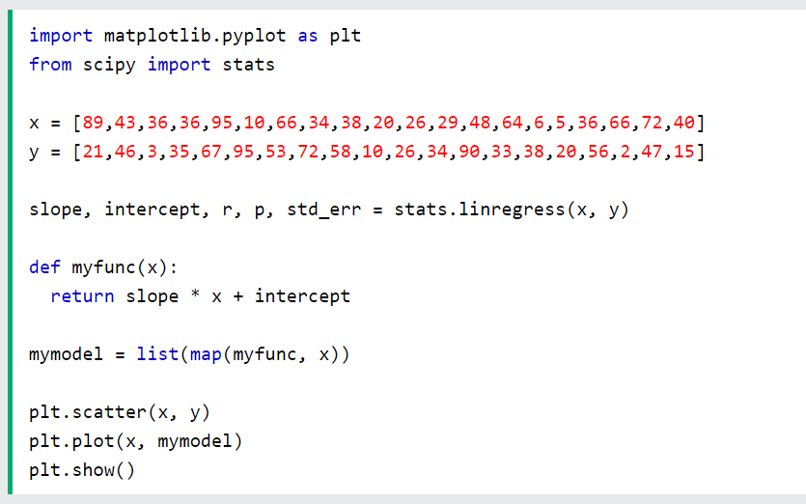
Machine Learning - Linear Regression
Continue…

Slide 50
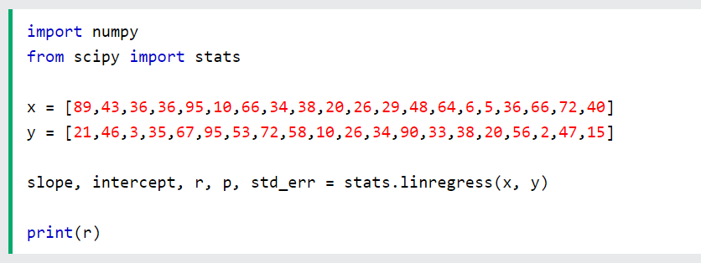
Machine Learning - Linear Regression
Note: The result: 0.013 indicates a very bad relationship, and tells us that this data set is not suitable for linear regression.
And the r for relationship?
Example
You should get a very low r value.

